Slide 2

Workshop 4. Set up Dev Environment & API Basics
Assignment 1 Solution
External API
LLM API
Assignment 2

Slide 3

Integrate LLM service using Python
Assignment 1
Make changes to the application
Provide an input box on the home page for user to enter the email paragraphs.
After user clicks the submit button, they should get a auto reply response printed on the home page output box.
The replied message should contain the email sender's name.
Assume all inputs have sender name attached at the end.
Example input
"Hi Foo, I have a question regarding my order status. Regards, Bryan."
Expected output
"Hi Bryan, thanks for your email. I will get back to you soon. Best, Foo."

Slide 4
Integrate LLM service using Python
Assignment 1 – Solutions
Example input
"Hi Foo, I have a question regarding my order status. Regards, Bryan."
Expected output
"Hi Bryan, thanks for your email. I will get back to you soon. Best, Foo."
Solution 1. String matching
Match the greetings at the beginning and the end of the email, extract the sender and the replier names.

Slide 5
Integrate LLM service using Python
Assignment 1 – Solutions
Solution 1. String matching
Implementation
views_util functions that extract sender and replier names using regular expression matching
Starting greetings
"Hello", "Hi", "Dear", "Miss", "Dr"
Ending greetings
"Regards", "Best", "Yours", "Sincerely"

Slide 6
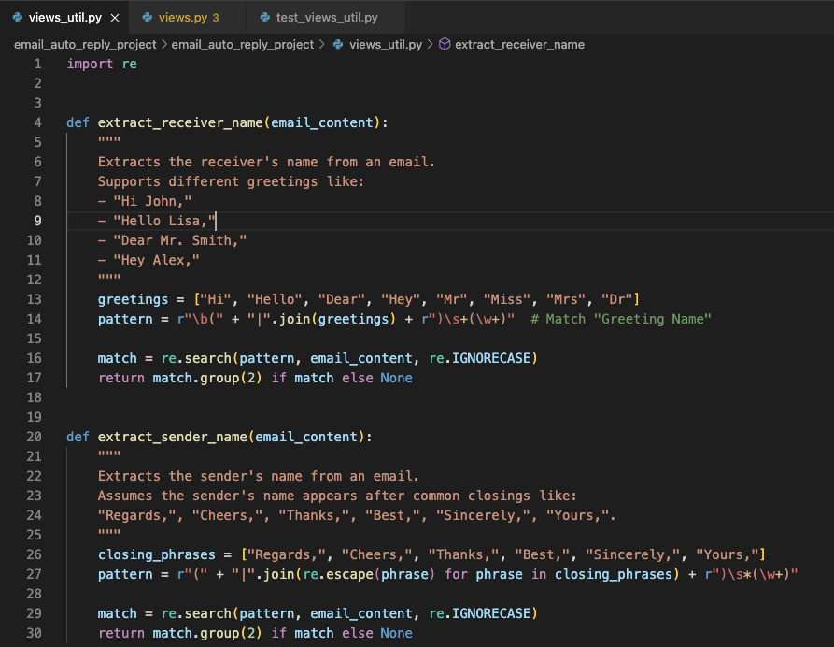
Integrate LLM service using Python
Assignment 1 – Solutions
Solution 1. String matching
Implementation
views_util.py

Slide 7
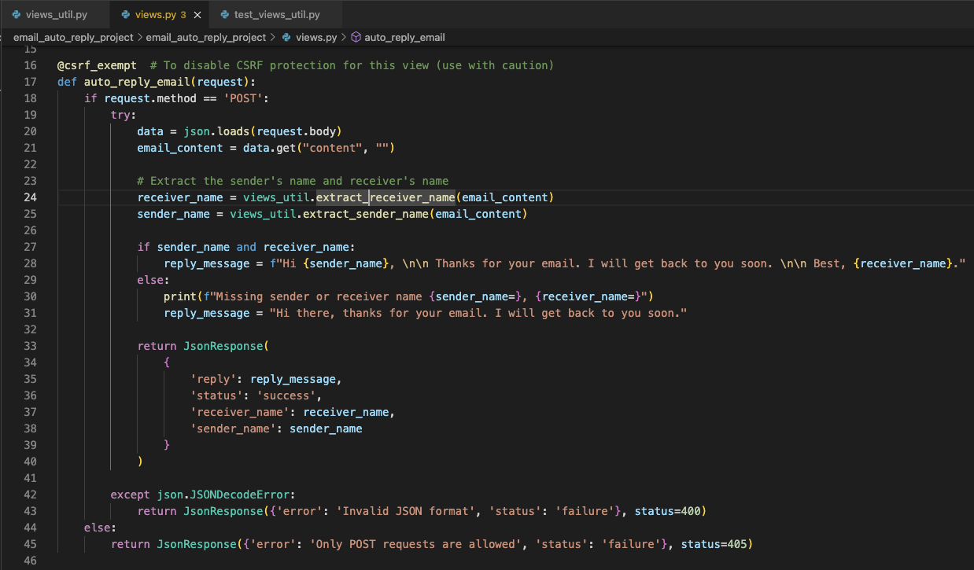
Integrate LLM service using Python
Assignment 1 – Solutions
Solution 1. String matching
Implementation
views_util.py
views.py

Slide 8
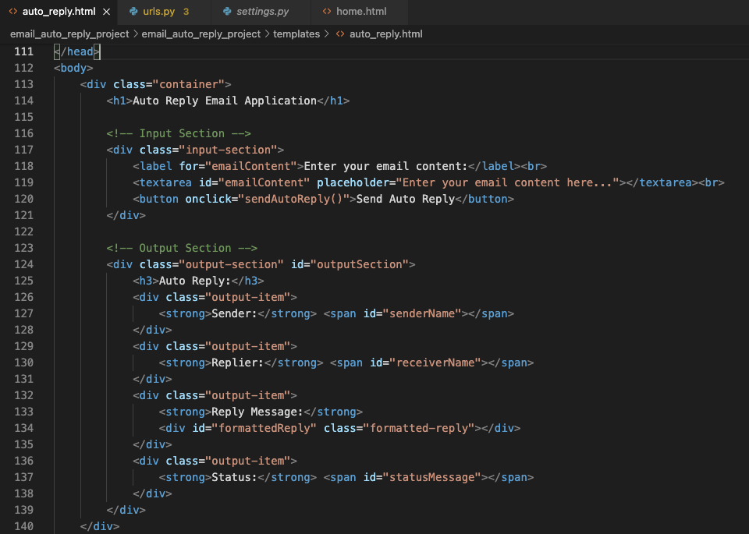
Integrate LLM service using Python
Assignment 1 – Solutions
Solution 1. String matching
Implementation
views_util.py
views.py
auto_reply.html

Slide 9
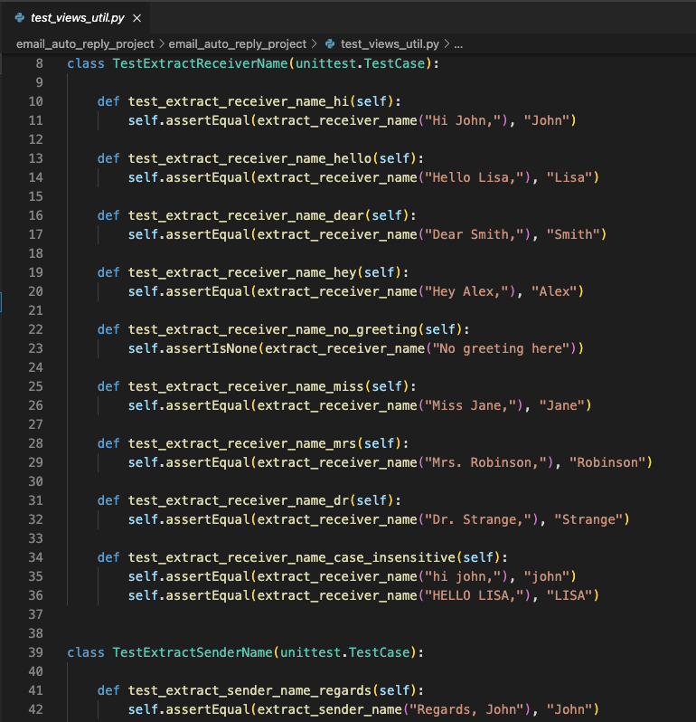
Integrate LLM service using Python
Assignment 1 – Solutions
Solution 1. String matching
Implementation
views_util.py
views.py
auto_reply.html
test_views_util.py

Slide 10
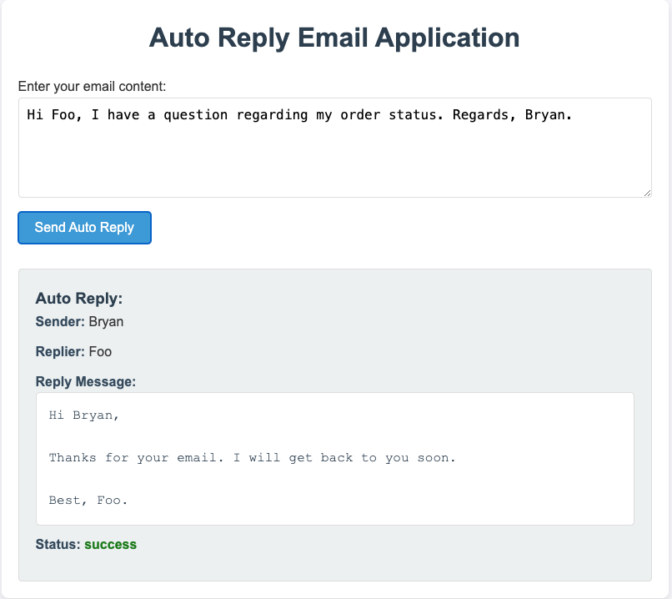
Integrate LLM service using Python
Assignment 1 – Solutions
Solution 1. String matching
Demo

Slide 11
Integrate LLM service using Python
Assignment 1
Submit assignment1 by March 8th. 2025
Reminder
The assignments are designed to showcase your ability of writing usable code and building software applications.
This is what makes a recruiter and an interviewer more willing to talk to you, rather than the other 70% of new grads with no proof of building real projects.
Assignments are incremental building blocks for your final project deliverable. Submit them on time will make your final weeks easier. The project certificate requires a final deliverable.

Slide 12

Any questions?

Slide 13
Workshop 4. Set up Dev Environment & API Basics
Assignment 1 Solution
External API
LLM API
Assignment 2

Slide 14
Integrate LLM service using Python
External API
Say someone was very into solving the name extraction problem, and have come up with an effective solution to solve this problem. He/she build a service so that you can input a paragraphs and it returns you the names extracted from it.
How to use and leverage external services?
API key
URL
Request body

Slide 15
Workshop 4. Set up Dev Environment & API Basics
Assignment 1 Solution
External API
LLM API
Assignment 2

Slide 16
Integrate LLM service using Python
LLM API
Providers
OpenAI - https://platform.openai.com
Anthropic
Google
Deepseek
Groq

Slide 17
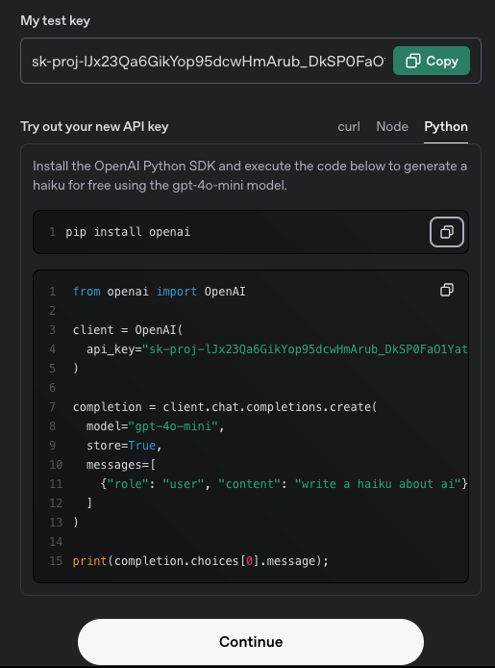
Integrate LLM service using Python
LLM API - OpenAI
1. Get API Key
Go to https://platform.openai.com and signup
Go to the API Keys section under account settings
Copy the key to your settings.py file

Slide 18
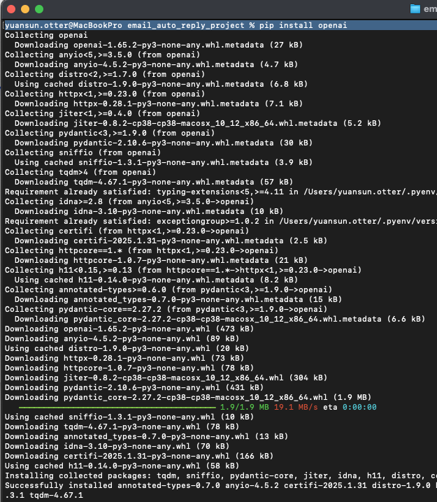
Integrate LLM service using Python
LLM API - OpenAI
2. Install OpenAI SDK in Python
In the directory where you start the local server
$ pip install openai

Slide 19
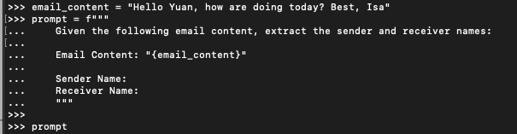
Integrate LLM service using Python
LLM API - OpenAI
3. Make your first API call
Write a prompt

Slide 20
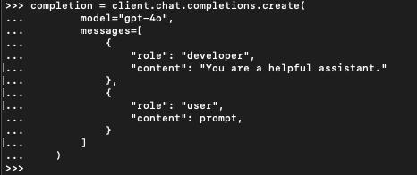
Integrate LLM service using Python
LLM API - OpenAI
3. Make your first API call
Write a prompt
Make request

Slide 21
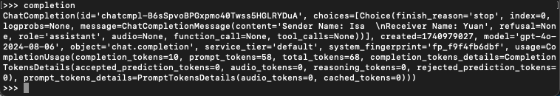
Integrate LLM service using Python
LLM API - OpenAI
3. Make your first API call
Write a prompt
Make request
Check response

Slide 22
Any questions?

Slide 23
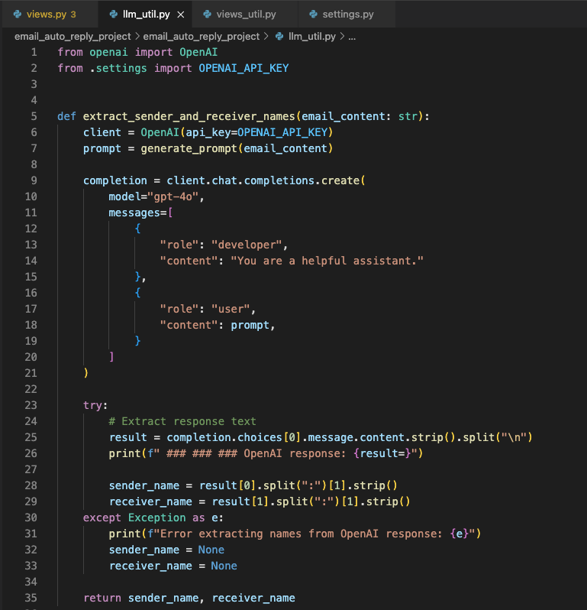
Integrate LLM service using Python
LLM API - OpenAI
4. Integrate into your application
llm_util.py

Slide 24
Integrate LLM service using Python
LLM API - OpenAI
5. Test and troubleshooting
Indeterminate response
Result = completion.choices[0].message.content.strip().split("\n")
Examples
result=['Sender Name: Jennie ', 'Receiver Name: Yuan']
result=['Based on the provided email content:', '', 'Sender Name: Jennie ', 'Receiver Name: Yuan']
Solution
Sol. 1. Regular expression, string parsing.
Sol. 2. Improve the prompt and ask for a determinate result.

Slide 25
Any questions?

Slide 26
Workshop 4. Set up Dev Environment & API Basics
Assignment 1 Solution
External API
LLM API
Assignment 2

Slide 27
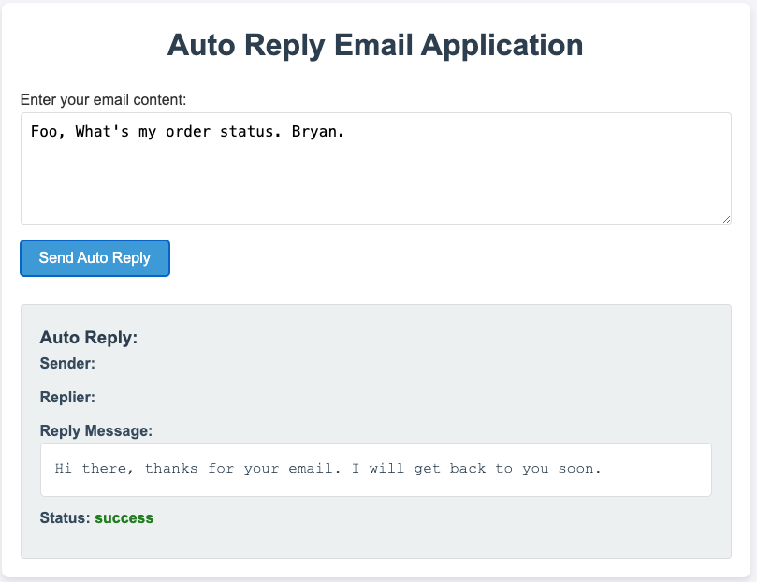
Integrate LLM service using Python
Assignment 1 – cont.
Solution 1. String matching
Limitation?
Infinite choices of greetings

Slide 28
Integrate LLM service using Python
Assignment 2
Improve the application based on assignment 1.
Solve the limitation from solution 1 and enhance the names extraction so that it works for all kinds of greeting style and email formatting.
Assume arbitrary inputs from users in real world.
Example input
"Foo, I have a question regarding my order status. Bryan."
"How are you doing recently Foo? Bryan"
...
Expected output
"Hi Bryan, thanks for your email. I will get back to you soon. Best, Foo."

Slide 29
Any questions?

Slide 30
Integrate LLM service using Python
Assignment 2
Submit your work
Record a video demo
Show the user flow with input of an email copies and check the output.
Try a few different email copies demonstrate it works for all.
Explain your solution and algorithm for this product feature.
Video recording tool Loom: https://www.loom.com/
Attach your video link to the project workspace folder
"BP - Feb, 2025 - Workspace with students" -> "Student's Assignments" -> "Assignment 2. " -> "firstname_last_name_assignment_2.url"
Shared folder link

Slide 31
Integrate LLM service using Python
Assignment 2
Submit assignment 2 by March 22nd. 2025

